Slide 1

Swift programming, SwiftUI
In this lession, you will learn:
- Basic Swift programming
- Swift functions, operators
- Define View/Sub Views in SwiftUI, send props to SubViews
- Local state management @State private var
- Anonymous functions with Closures

Slide 2
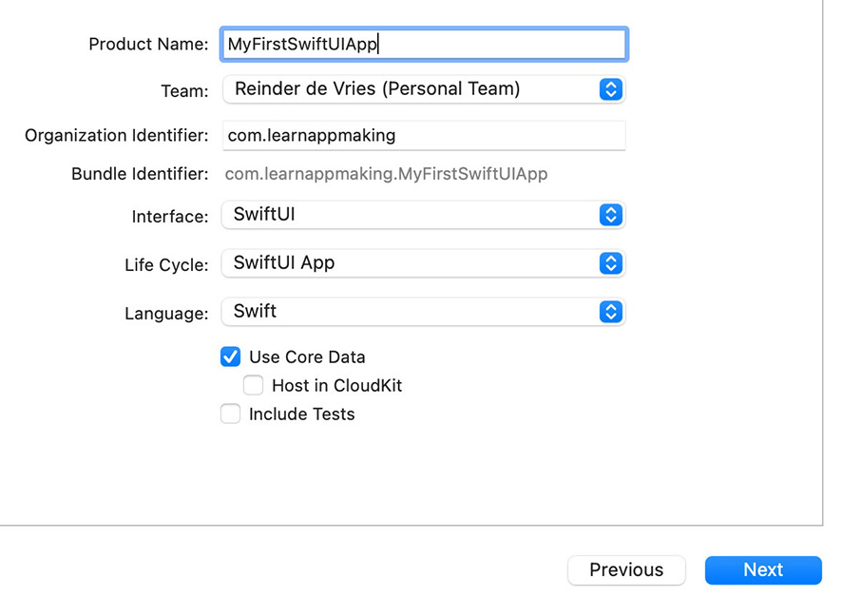
Create your first project
Installing documents is quite clear. Please make sure that you installed these items:
- Latest MacOS(version 12, Monterey)
- Xcode and Command Line Tool
- Let’s create a new SwiftUI project after installing Xcode
-Core Data is used for storing data to local Database => optional
- Login to your Developer Account if you need to test your App in Physical devices

Slide 3
Constants/Variables with let, var
Constants and variables must be declared before they’re used. You declare constants with the let keyword and variables with the var keyword.
var red, green, blue: Double
let π = 3.14159
//You can declare multiple constants or multiple variables on a single line
var x = 0.0, y = 0.0, z = 0.0
//semicolons are required if you want to write multiple separate statements on a single line
let cat = "🐱"; print(cat)// Prints "🐱“
//Swift has a basic Boolean type, called Bool
let orangesAreOrange = true
let turnipsAreDelicious = false

Slide 4
Tuples, optional/exclaimation values
Tuples group multiple values into a single compound value. The values within a tuple can be of any type and don’t have to be of the same type as each other
let http404Error = (404, "Not Found")
let (statusCode, statusMessage) = http404Error
print("The status code is \(statusCode)")
// Prints "The status code is 404"
print("The status message is \(statusMessage)")
// Prints "The status message is Not Found"
var serverResponseCode: Int? = 404//Optional type can contain nil value
serverResponseCode = nil
//You can make sure that a variable has "NOT NIL" data:
let assumedString: String! = "this is a string."

Slide 5
Functions and parameters
To use a function, you must define it somewhere in the scope from which you wish to call it.
func minMax(array: [Int]) -> (min: Int, max: Int) {
var currentMin = 1
var currentMax = 2
//some calculations
return (currentMin, currentMax)
}
//function that return a function
func chooseStepFunction(backward: Bool) -> (Int) -> Int {
return backward ? stepBackward : stepForward
}
//stepBackward, stepForward are 2 functions
func stepForward(_ input: Int) -> Int {
return input + 1
}

Slide 6
Functions and parameters
If you don’t want an argument label for a parameter,
write an underscore (_) instead of an explicit argument label for that parameter.
func someFunction(_ firstParameterName: Int,
secondParameterName: Int,
parameterWithDefault: Int = 12) {
//You can define a default value for any parameter
//..some code here
}
someFunction(1, secondParameterName: 2)
//Variadic Parameters
func arithmeticMean(_ numbers: Double...) -> Double {
//..some code here
return 123
}
arithmeticMean(3, 5)
arithmeticMean(1, 2, 3, 4, 5)

Slide 7
Dictionary in Swift
Dictionary is a type of hash table, each entry in the table is identified using its key, which is a hashable type such as a string or number.
var interestingNumbers = ["primes": [2, 3, 5, 7, 11, 13, 17],
"triangular": [1, 3, 6, 10, 15, 21, 28],
"hexagonal": [1, 6, 15, 28, 45, 66, 91]]
for key in interestingNumbers.keys {
interestingNumbers[key]?.sort(by: >)
}
print(interestingNumbers["primes"]!)
// Prints "[17, 13, 11, 7, 5, 3, 2]"
let imagePaths = ["star": "/glyphs/star.png",
"portrait": "/images/content/portrait.jpg",
"spacer": "/images/shared/spacer.gif"]
for (name, path) in imagePaths {
print("The path to '\(name)' is '\(path)'.")
}

Slide 8
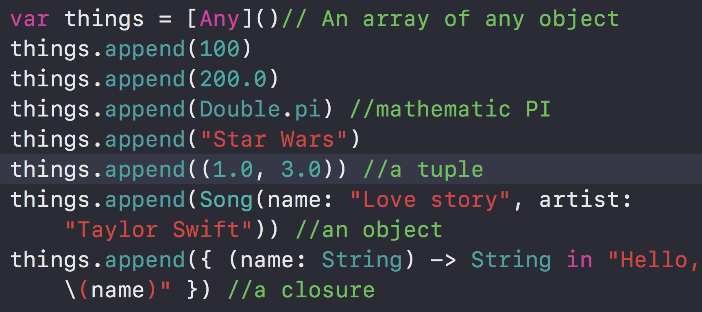
Array of Any Objects
An array of Any object can contain multiple types of values

Slide 9
Views in SwiftUI
A View can be a struct. A screen can contain multiple components, a screen is also a component. A basic component contains props, state, build-in components(TextField,Text,…)
struct SelectBodyType: View {
var body: some View {
VStack{
UIHeader(
onPressLeft: {
print("left")
}, onPressRight: {
print("right")
}, title: "")
Spacer()
Text("What's your Body Type ?")
}
}
}

Slide 10
Structures and Classes
Structures and classes have a similar definition syntax. You introduce structures with the struct keyword and classes with the class keyword
struct Resolution {
var width = 0
var height = 0
}
class VideoMode {
var resolution = Resolution()
var interlaced = false
var frameRate = 0.0
var name: String?
}
//you need to create an instance of the structure or class
let someResolution = Resolution()
let someVideoMode = VideoMode()
//memberwise initializer
let vga = Resolution(width: 640, height: 480)

Slide 11
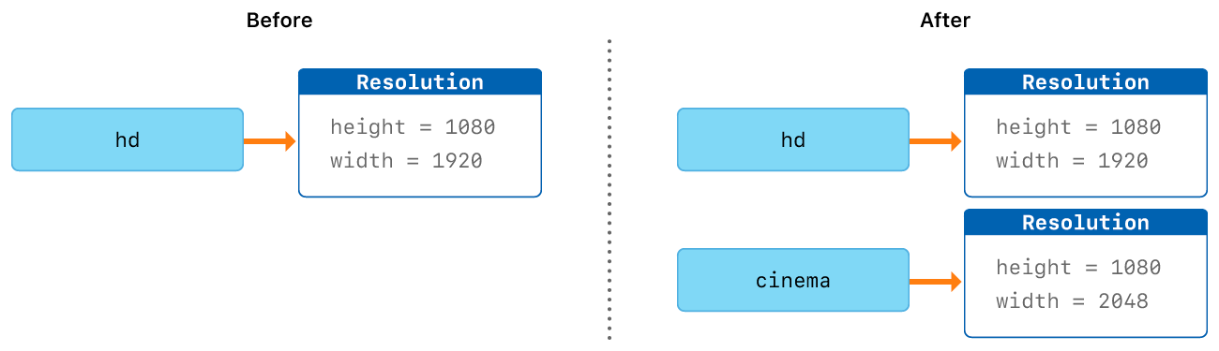
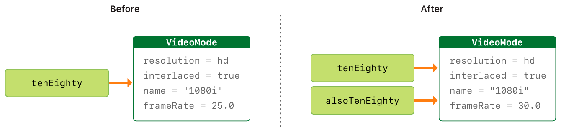
Structures and Classes
Structures and Enumerations Are Value Types
Classes Are Reference Types

Slide 12
Extensions
Extensions add new functionality to an existing class, structure, enumeration, or protocol type.
extension Int {
mutating func square() {
self = self * self
}
}
var someInt = 3
someInt.square()
// someInt is now 9
extension Rect {
init(center: Point, size: Size) {
//some code here
}
}

Slide 13
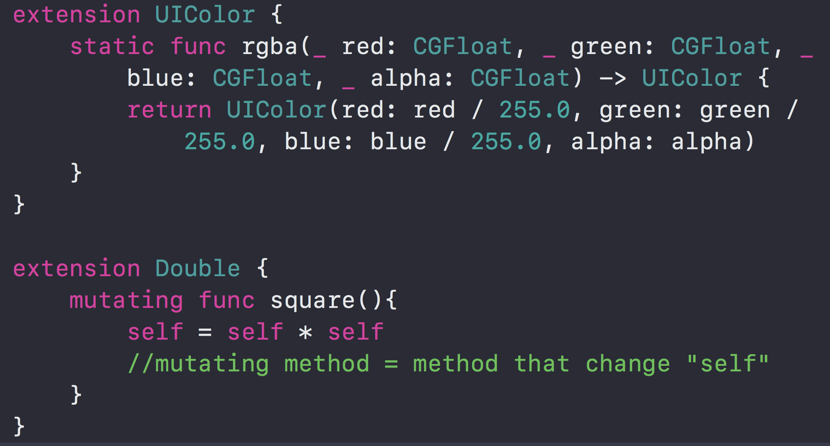
Extensions
Let’s see an example of adding methods/properties into UIColor and Double classes:

Slide 14


